Slide 1
OWASP TOP 10
Manjunathan C
Security Analyst

Slide 2
Synopsis
Introduction
Web App pen testing
OWASP
OWASP top 10
Conclusion

Slide 3
Introduction
In today’s modern world everything is being modernized.
Just as security features are increasing day by day, at the same time users information being stolen Sometimes due to the Illegal hackers and sometimes due to the careless of the security system officials.
To identify and fix those vulnerabilities many organizations like OWASP have released many security standards based on the impact of the vulnerability.
Today I take a session about OWASP top 10 vulnerabilities

Slide 4
Web App Pen testing
It is the process of using penetration testing techniques on a web application to detect its vulnerabilities.
We can find Vulnerabilities by using automate tools or by manual testing.
There are multiple vulnerabilities can be found in an web app which we can see later in OWASP top 10 this session
Web app pen testing has 5 parts.
Planning and reconnaissance, Scanning, Gaining Access, Maintaining access, Analysis

Slide 5
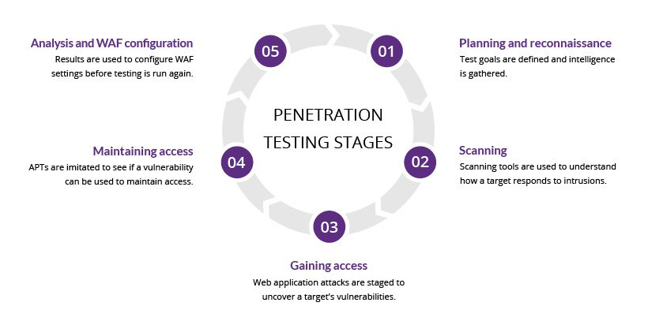
Stages
Planning and reconnaissance
Scanning
Gaining Access
Maintaining access
Analysis

Slide 6
OWASP
Open Web Application Security Project
The Open Web Application Security Project (OWASP) is a non-profit foundation dedicated to improving the security of software.
OWASP maintains the Top 10 list of vulnerabilities and has done so since 2003. Every 2-3 years the list is updated in accordance with advancements and changes in the AppSec market.
It serves as a key checklist and internal Web application development standard for many of the world’s largest organizations.

Slide 7
OWASP top 10
Injection
Broken Authentication
Sensitive Data Exposure
XML External Entities(XXE)
Broken Access Control
Security Misconfiguration
Cross Site Scripting
Insecure Deserialization
Using Components with Known Vulnerabilities
Insufficient Logging & Monitoring

Slide 8
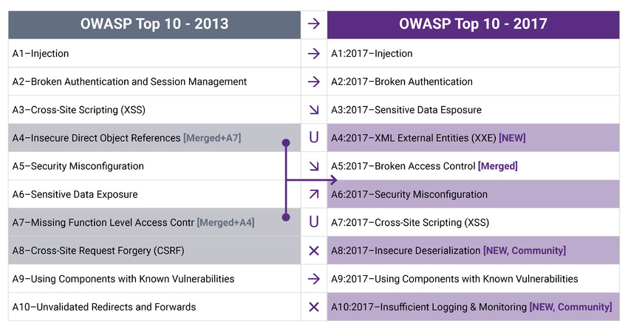
Changes(2013-2017)

Slide 9
Injection
A code injection occurs when invalid data is sent by an attacker into a web application. The attacker’s intent in doing so is to make the application do something it was not designed to do.
Example: SQL injection
Impact: HIGH
Prevention:
Use positive or “whitelist” server-side input validation
Escape special characters
Use LIMIT and other SQL controls within queries to prevent mass disclosure of records in case of SQL injection.

Slide 10
Broken Authentication
A web application with broken or weak authentication can be easily detected by attackers.
Example: brute force/dictionary attacks and session management attacks
Impact: HIGH
Prevention:
Implement Multi factor authentication
Expire session after regular intervals or any updates in login data.

Slide 11


Slide 12
Sensitive data Exposure
Sensitive data exposure is when important stored or transmitted is compromised.
Example: Directory Listing, Sensitive data leakage while browsing,LFI
Impact: High(as per the data)
Prevention:
Identify sensitive data and apply appropriate security controls.
Don’t store sensitive data unless absolutely needed
Encrypt all sensitive data at rest using strong encryption algorithms, protocols and keys.
Disable caching for sensitive data

Slide 13
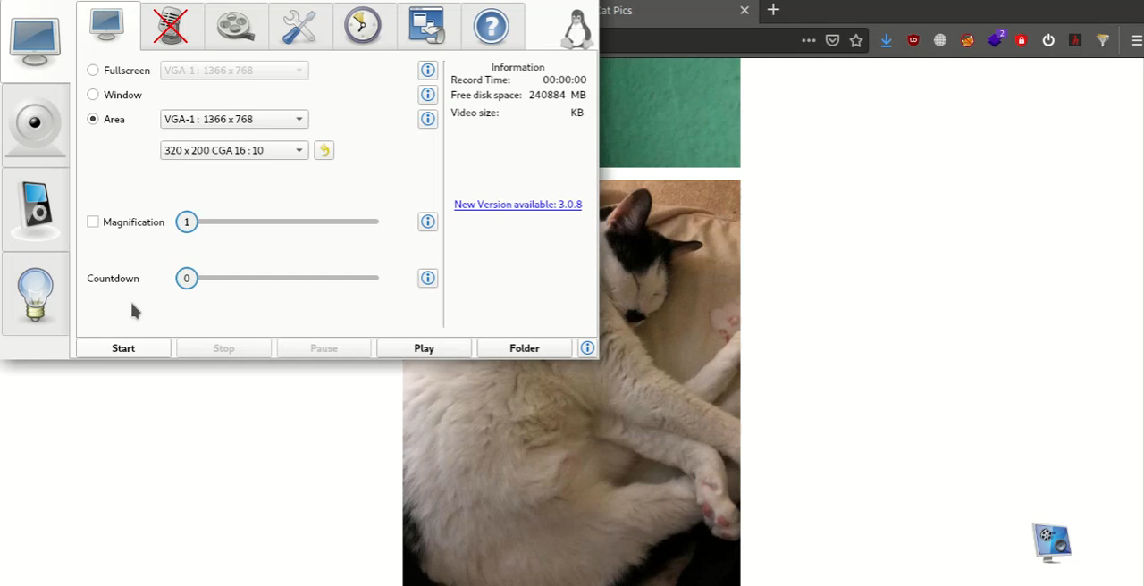

Slide 14
XML External Entities(XXE)
If a web application uses a vulnerable component processing XML, attackers can upload XML or include hostile content, commands or code within an XML document.
Example: An application allows untrusted sources to perform XML uploads.
Impact: High
Prevention:
Use simpler data formats like JSON and avoid serialization
Patch or upgrade all XML processors and libraries
Disable XML external entity and DTD processing

Slide 15
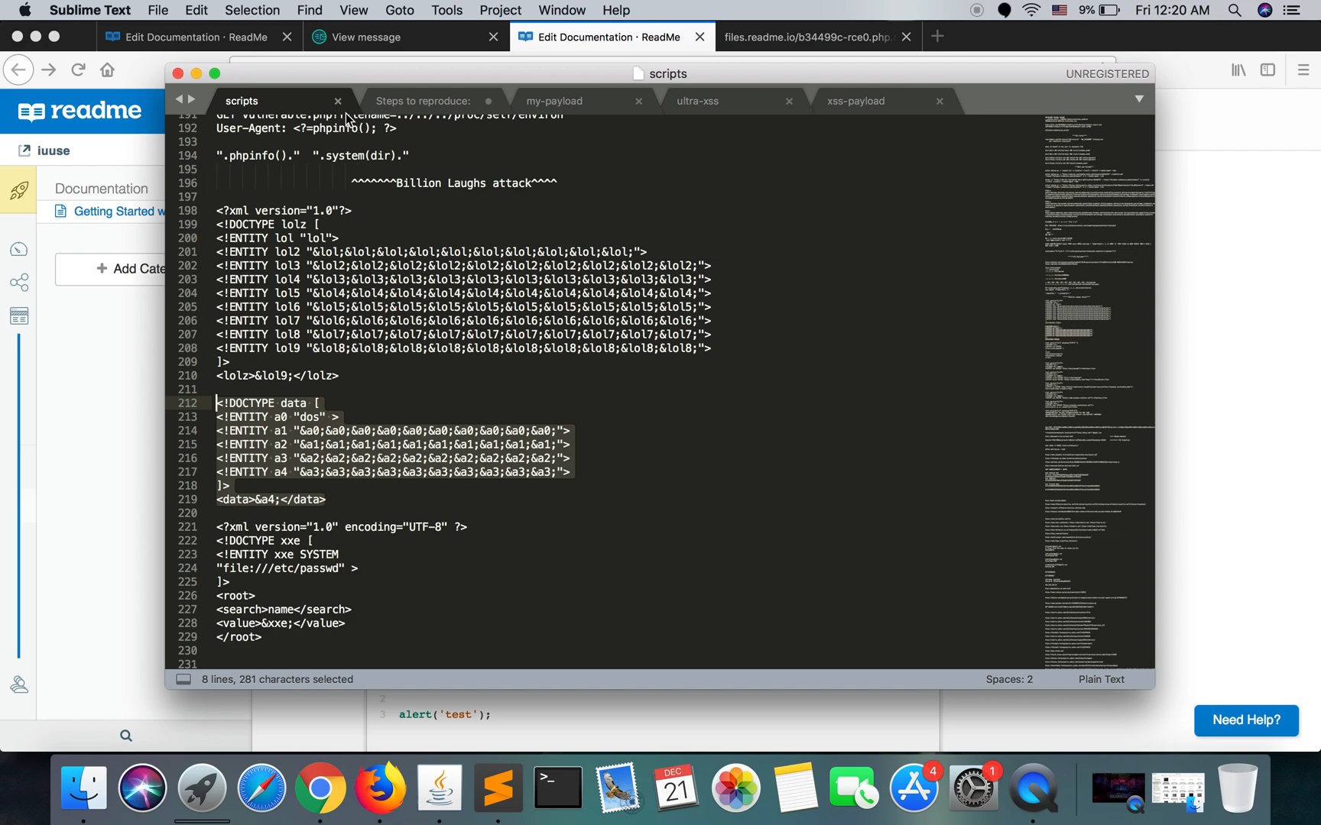

Slide 16
Broken Access Control
Broken access control means that attackers can gain access to user accounts and act as users or administrators, and that regular users can gain unintended privileged functions. Strong access mechanisms ensure that each role has clear and isolated privileges.
Example: An application allows a primary key to be changed. When the key is changed to another user’s record, that user’s account can be viewed or modified.
Impact : HIGH
Prevention:
Deny access by default, except for public resources
Build strong access control mechanisms and reuse them across the application
Enforce record ownership don’t allow users to create, read or delete any record
Enforce usage and rate limits

Slide 17
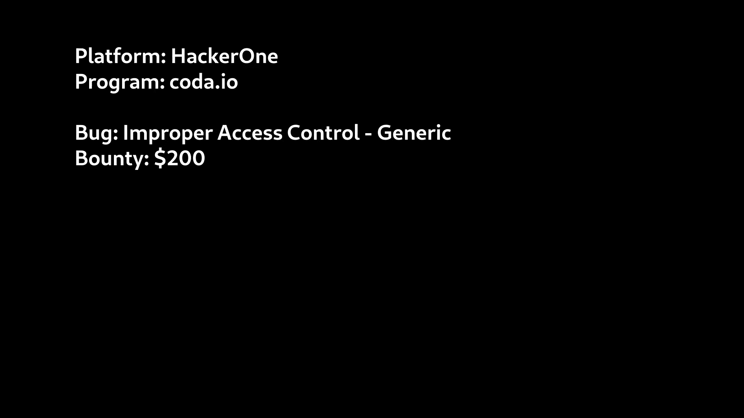

Slide 18
Security Misconfiguration
Misconfigured security controls are a common entry point for attackers. These are when design or configuration weaknesses result from a configuration error or shortcoming. simply said as failing to implement all the security controls for a server or web application
Example: A database deployed with a default admin password, Directory Listing
Impact : Medium
Prevention:
Disable administration interfaces.
Disable debugging.
Disable use of default accounts/passwords.
Configure server to prevent unauthorized access, directory listing, etc.

Slide 19
Cross Site Scripting
It is a type of injection, in which attacker inject their payload to retrieve sensitive information such as user cookies An attacker can use XSS to send a malicious script to an unsuspecting user.
Types:
Reflected,
Stored,
Dom
Impact: Medium or High

Slide 20
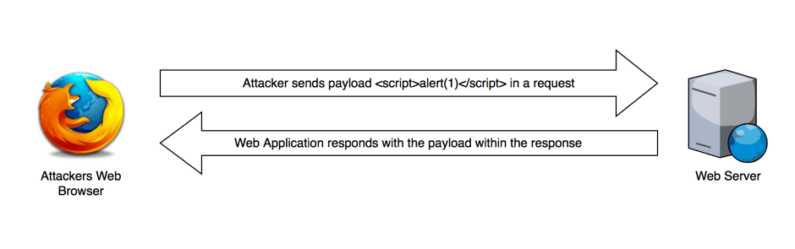
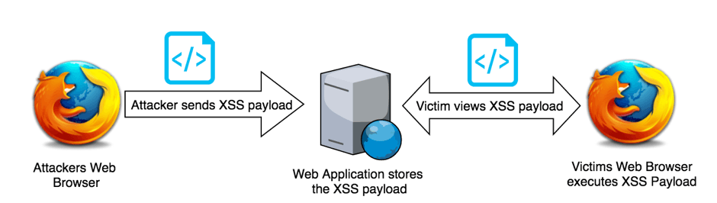
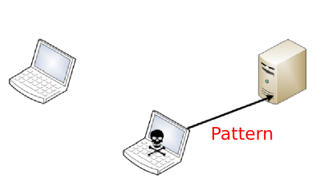
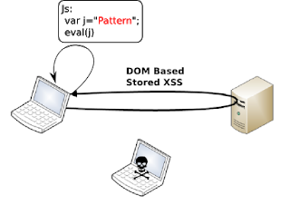

Slide 21
Model Reports
Reflected XSS: https://hackerone.com/reports/789652
Stored XSS: https://hackerone.com/reports/647130
DOM based XSS: https://hackerone.com/reports/949382

Slide 22
Insecure Deserialization
Insecure Deserialization is a vulnerability where deserialization flaws allow an attacker to remotely execute code in the system. It is a complex technique, but if executed correctly, it allows attackers to execute malicious code on a server.
Example: An attacker changes the serialized object to give themselves admin privileges
Impact: High
Prevention:
prefer standard formats such as JSON or YAML as opposed to native binary formats.
when possible, include positive validation based on signatures for serialized data. Never trust data that has been provided by the user.

Slide 23
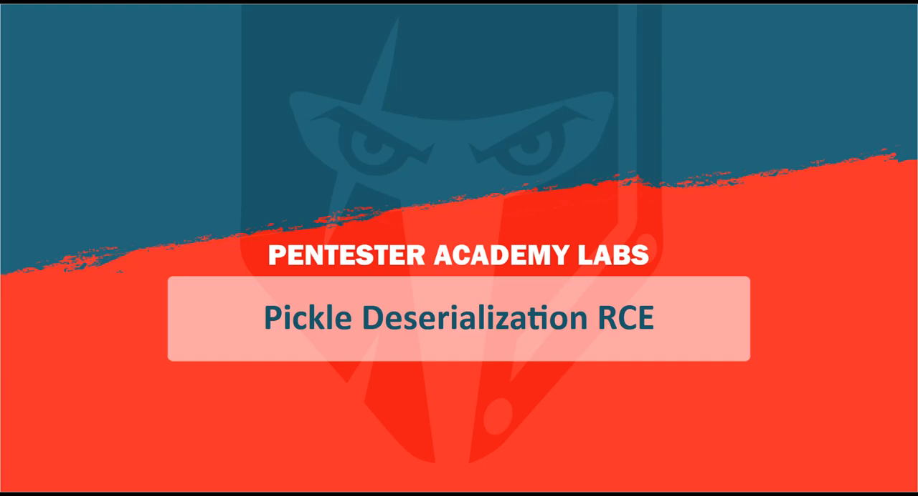

Slide 24
Using Components with Known Vulnerabilities
This vulnerability’s title states its nature; it describes when applications are built and run using components that contain known vulnerabilities.
Example: Attack web apps if they use older version components and exploit vulnerabilities which is exists in that component
CTF’s and vulnerable machine
Prevention:
Use updated version of components always

Slide 25
Insufficient Logging And Monitoring
Logging and monitoring are activities that should be performed to a website frequently, to guarantee it is secure. Failure to adequately log and monitor a site leaves it vulnerable to more severe compromising activities.
Example: Attacker attacks organization, But the organization doesn’t know about the attack due to Insufficient Logging And Monitoring
Prevention:
Ensure that logs are generated in a format that can be easily consumed by a centralized log management solutions.
Ensure high-value transactions have an audit trail with integrity controls to prevent tampering or deletion, such as append-only database tables or similar

Slide 26
Conclusion
As always said, no website is 100% secure.
It is your duty to protect your information from being stolen
If you suspect any website or any data asking platform is not safe to protect your data, just leave from there.
Try to keep your data always private.
Finally don’t forget one thing you are the front-line defender of your data

Slide 27
THANK YOU

